Slide 1

University of Minnesota Data Visualization and Analytics Boot Camp Project 1 What makes a song a hit?
Team 2:
Lauren Cadogan
Zachary Herrera
Mankwe Ndosi
Omar Espinoza
November 14, 2022

Slide 2
General Description
In this project, we wanted to explore the question of what makes a song popular.
Taste for music is highly subjective, so we were curious if success factors could be analyzed in a quantitative way.
We needed a dataset that contained song properties and song popularity indicators.
Relationships, associations, and trends were uncovered using quantitative data, mostly with visualizations.

Slide 3
Questions
Overall: What makes a song a hit?
Specific:
What do top 200 songs have in common?
How genre and popularity change over time?
Do any of these properties predict popularity?
Danceability
Energy
Acousticness
Liveness
Tempo
Duration

Slide 4

Dataset
Spotify top 200 dataset: charts top 200 songs between 2017-2021
74,661 rows and 40 columns = 2,986,440 items
10 data types (char, tinyint, varchar, bool, date, smallint, decimal, blob, float, int)
Sources: Spotify API, Spotify Charts, reference dataset
https://www.kaggle.com/datasets/younver/spotify-top-200-dataset?select=spotify-top-200-dataset.csv
https://developer.spotify.com/documentation/web-api/reference/#/operations/get-audio-features

Slide 5
Data Cleanup and Exploration
We dropped rows with NA values, roughly 1,000 rows.
Many songs with more than one author were listed multiple times. Those duplicates were eliminated. We used drop_duplicates() for rows that had a matching track name, rank and week. About 30,000 rows.
We merged the data with a genre file which simplified the number of unique genre values, to 6 categories (from 485).
Using value_counts() we tested to see which genre and which track name hit the charts the most frequently.
Clean dataset spotify_clean.csv : 44,134 rows and 15 columns (from 74.7K rows and 40 columns)
For time series, we converted weeks to quarters, and used seaborn and matplotlib to plot the number of streams per genre over time
Notes:
* Describe the exploration and cleanup process
* Discuss insights you had while exploring the data that you didn't anticipate
* Discuss any problems that arose after exploring the data, and how you resolved them
* Present and discuss interesting figures developed during exploration, ideally with the help of Jupyter Notebook

Slide 6
Clean Dataset - Variables
Independent
Dependent
artist_followers: number of followers
artist_popularity: 1-100 scale
danceability: 0= least danceable
energy: intensity/activity
acousticness: >0.5 instrumental
liveness: >0.8 likely live song
tempo: beats per minute (BPM)
duration: miliseconds
streams: number of times a song has been streamed

Slide 7
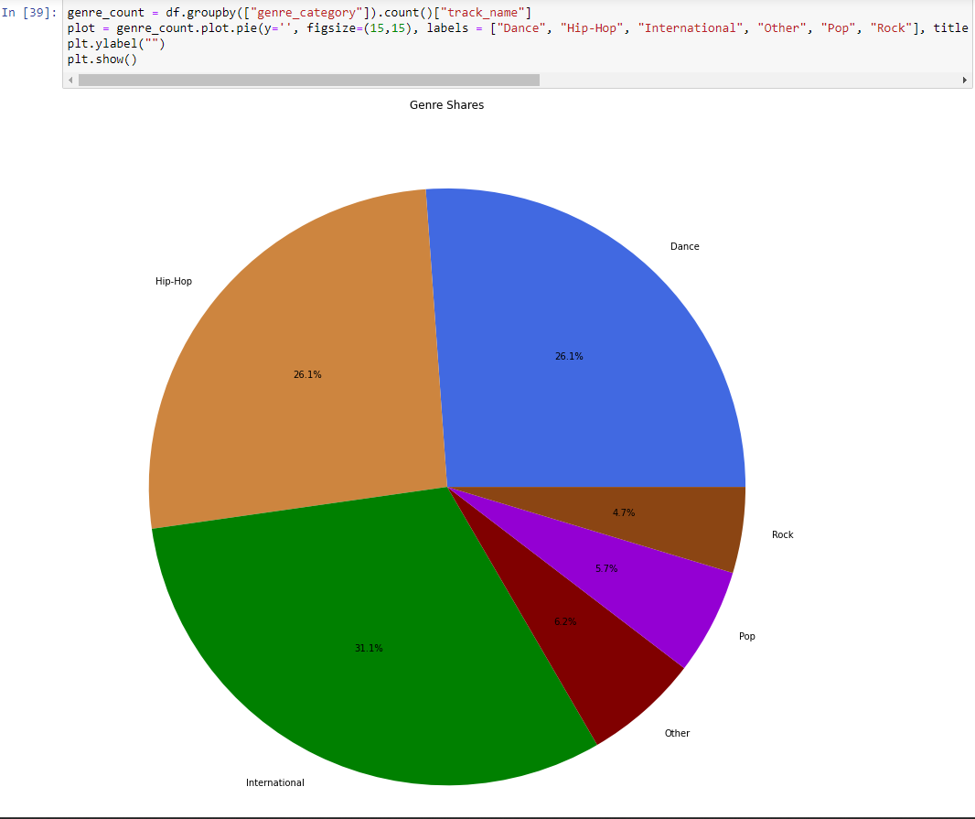
Question 1: What do top 200 songs have in common?
Over the period of analysis (2017-2021) the “International” genre represents the 31% of all streams, followed by “Hip-Hop” and “Dance” (both 26%).
“Rock” and “Pop” songs represented 5% and 6% of all streams.
Notes:
Discuss the steps you took to analyze the data and answer each question you asked in your proposal
Present and discuss interesting figures developed during analysis, ideally with the help of Jupyter Notebook

Slide 8
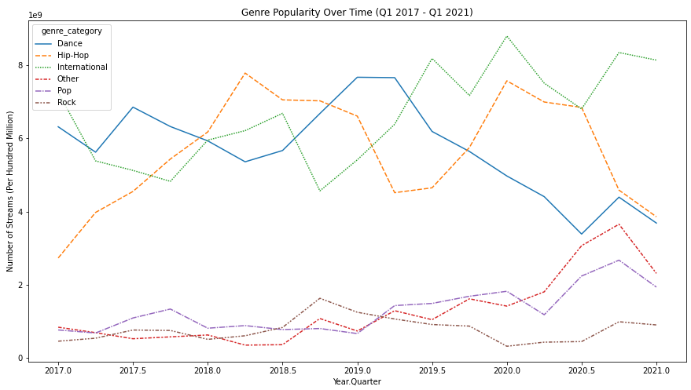
Question 2: How does genre and popularity change over time?
Streams of “Dance” songs declined from mid-2019. Similar trend for Hip-Hop from early 2020.
Steady increase of streams of “International” songs, maybe reflecting change in audience or growing Spotify adoption overseas. Similar increase in “Others”, starting in 2018.
Notes:
Discuss the steps you took to analyze the data and answer each question you asked in your proposal
Present and discuss interesting figures developed during analysis, ideally with the help of Jupyter Notebook

Slide 9
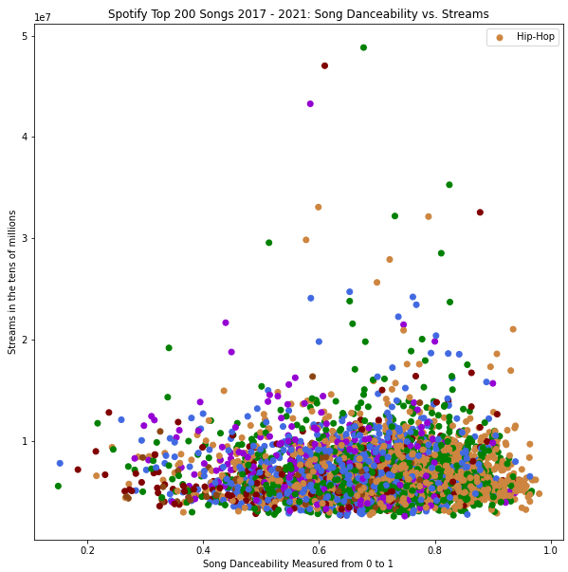
Question 3: What song properties predict popularity better? - Danceability
Slight concentration of songs were observed at higher “danceability” scores (between 0.6 and 0.9)
Notes:
Discuss the steps you took to analyze the data and answer each question you asked in your proposal
Present and discuss interesting figures developed during analysis, ideally with the help of Jupyter Notebook

Slide 10
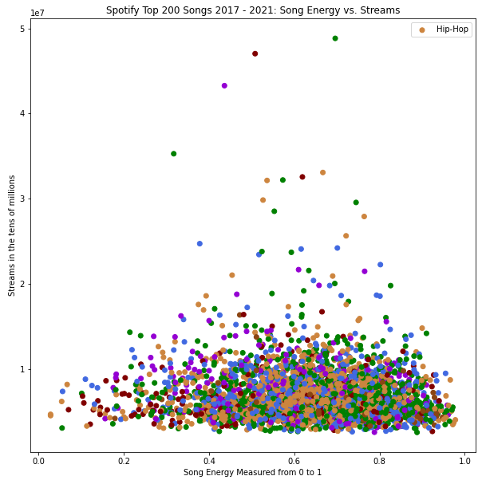
Question 3: What song properties predict popularity better? - Energy
Slight concentration of songs with energy scores above 0.5.
Notes:
Discuss the steps you took to analyze the data and answer each question you asked in your proposal
Present and discuss interesting figures developed during analysis, ideally with the help of Jupyter Notebook

Slide 11
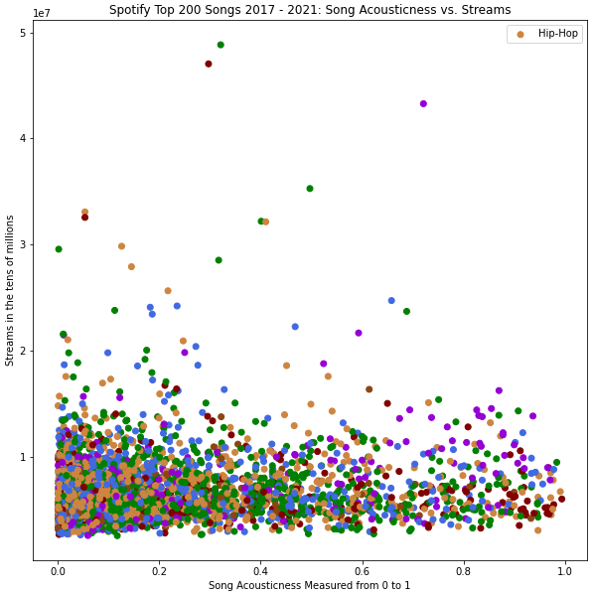
Question 3: What song properties predict popularity better? - Acousticness
More instrumental songs (higher “acousticness” score) were streamed less than non-acoustic songs.
Notes:
Discuss the steps you took to analyze the data and answer each question you asked in your proposal
Present and discuss interesting figures developed during analysis, ideally with the help of Jupyter Notebook

Slide 12
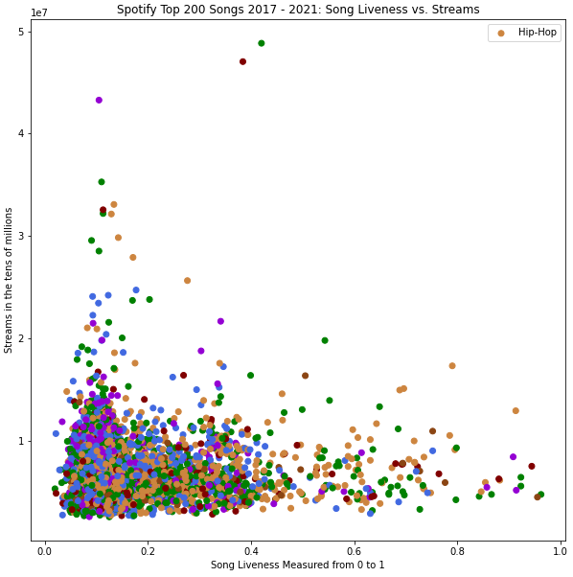
Question 3: What song properties predict popularity better? - Liveness
Live songs (>0.8) were streamed less than studio songs.
Notes:
Discuss the steps you took to analyze the data and answer each question you asked in your proposal
Present and discuss interesting figures developed during analysis, ideally with the help of Jupyter Notebook

Slide 13
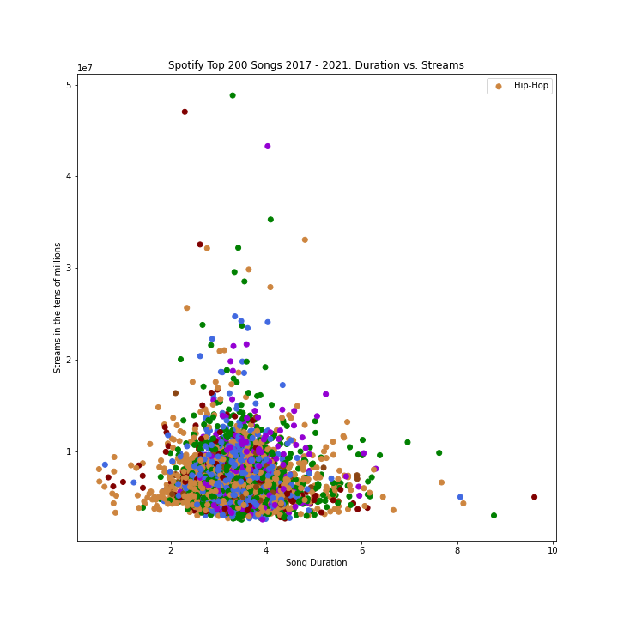
Question 3: What song properties predict popularity better? - Duration
Songs that were between 2.5 and 4 minutes long were streamed more times.
Notes:
Discuss the steps you took to analyze the data and answer each question you asked in your proposal
Present and discuss interesting figures developed during analysis, ideally with the help of Jupyter Notebook

Slide 14
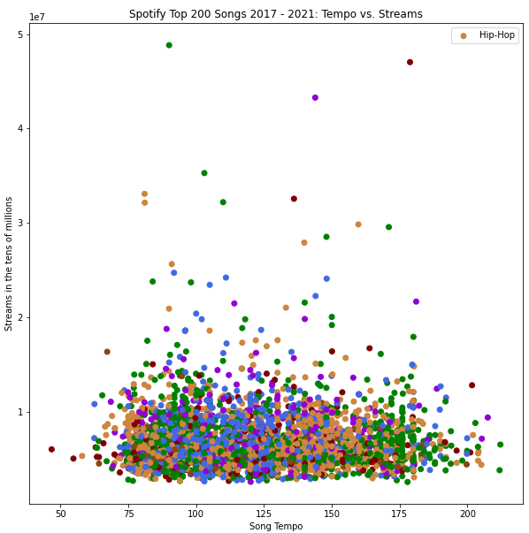
Question 3: What song properties predict popularity better? - Tempo
Slightly more streams were observed for songs with tempo between 75 and 150 beats per minute (bpm).
Notes:
Discuss the steps you took to analyze the data and answer each question you asked in your proposal
Present and discuss interesting figures developed during analysis, ideally with the help of Jupyter Notebook

Slide 15
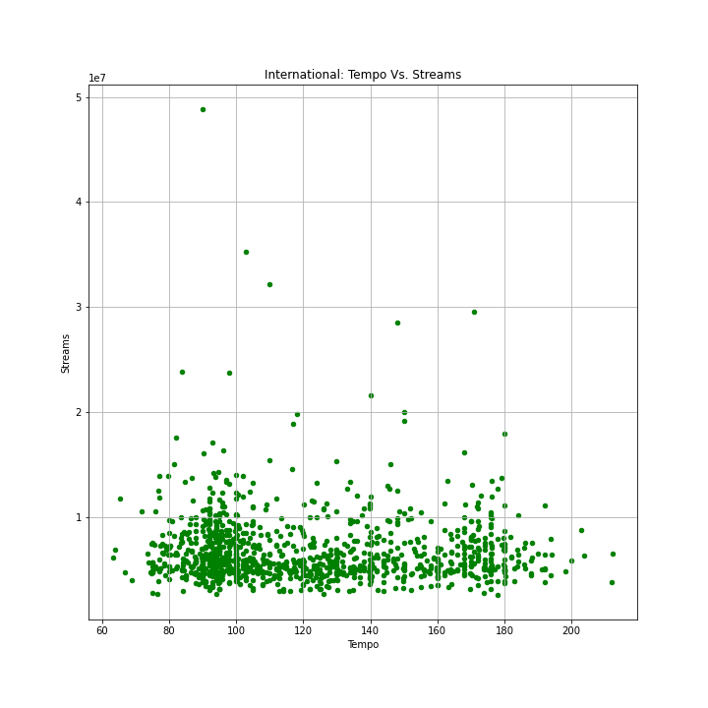
Question 3: What song properties predict popularity better? - Tempo - International
For the International genre, two preferred values of tempo seem to exist, at about 95 bpm and 175.
Notes:
Discuss the steps you took to analyze the data and answer each question you asked in your proposal
Present and discuss interesting figures developed during analysis, ideally with the help of Jupyter Notebook

Slide 16
Summary of Findings
International music has increased and Dance music has decreased in terms of presence in the top 200 in the past few years.
Genre presence in the top 200 fluctuates a lot quarter to quarter.
Liveness and Acousticness negatively correlate with streams.
There is a sweet spot in duration of 2.5 to 4 minutes.
The remaining factors had little impact on streams.
Notes:
* Describe whether you were able to answer these questions to your satisfaction, and briefly summarize your findings

Slide 17
Implications
Findings can be useful input for music streaming platforms, record label, artists.
Our findings suggest that even in categories where streams is not dependent on the factor (EG. danceability, energy) there are more songs in specific ranges.

Slide 18
Dataset Limitations
Music is highly subjective!
Song properties:
Objective: tempo, duration, # of streams
Subjective: danceability, liveness, acousticness, energy, genre
Conclusions cannot be extrapolated. May include bias from user profiles (Millennials and Gen Z, most in Europe, more female/male).
Results may be different if other databases are included (Apple Music, Amazon Music, SoundCloud, Pandora, Deezer, Tidal, etc.)
Data may not be representative, includes pandemic (2020-21) period.
By reducing music genres to only 6, we have led to oversimplification and the loss of information.

Slide 19
Lessons Learned
What would we do differently?
Narrow down to top 50 or 10
Generate descriptive statistics (mode, median, std. dev.)
Further research
Multiple regression analysis
Cross reference with other datasets
Add interactive features, queries
Notes:
* Discuss any difficulties that arose, and how you dealt with them
* Discuss any additional questions that came up, but which you didn't have time to answer: What would you research next, if you had two more weeks?

Slide 20
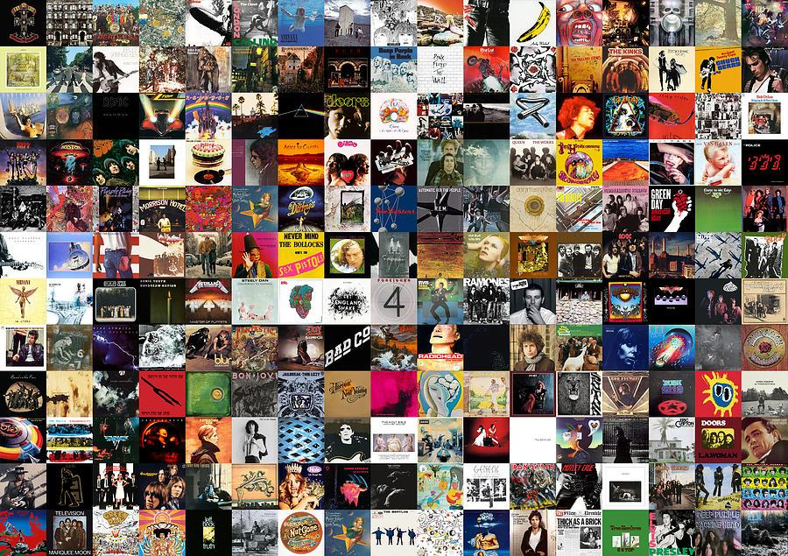
Questions?

